Slide 1
Respiratory System
(The Lungs and Breathing)

Slide 2
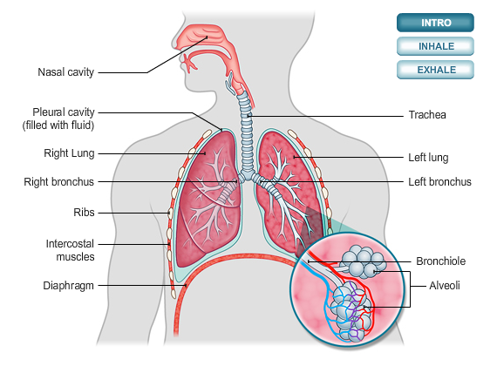
The Layout of the Respiratory Organs

Slide 3
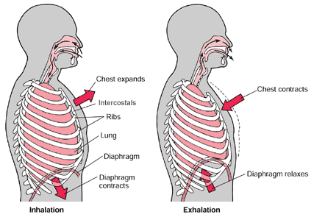
Breathing
Before Exercise
After intense exercise
Breathing is regular
Breaths have less volume
Enough oxygen is being provided to the muscles
Breathing is frantic
Breaths have more volume
Not enough oxygen is provided to the muscles after exercising because the muscles have used it up. This leaves them body in oxygen debt.
Breathing is heavy (gulping in large amounts of air) to repay the oxygen debt

Slide 4
Mechanics of breathing
Inspiration – breathing in
Expiration – breathing out
Intercostal muscles contract
Ribs move up & out
Diaphragm contracts and flattens
Chest expands increasing space
Air pressure decreases
Air is drawn in to lungs
Intercostal muscles relax
Diaphragm relaxes becoming domed
Chest becomes smaller
Air pressure increases
Air is expelled from lungs

Slide 5
Obtaining Energy
Carbohydrates in the form of starch from foods such as bread, pasta and potatoes form most of our energy supply
The starch is digested into glucose molecules and passed into the blood
As well as in the liver and muscles, glucose is diffused easily into the body cells and is used to meet the energy demand via respiration

Slide 6
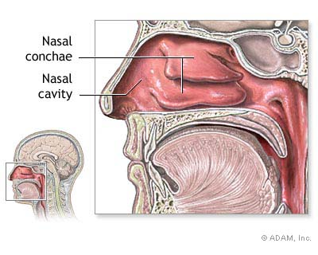
Nasal System
Humidifying and heating of inhaled air because of slow air turnover in this region.
Dust and particles are filtered by short thick hairs, vibrissae, in the nasal cavity.

Slide 7
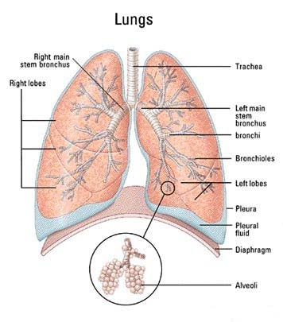
Lungs
The job of the lungs is to provide oxygen to the rest of the body. In addition to providing the body with oxygen the lungs also adjust the Ph of the blood by regulating the carbon dioxide levels in the blood.

Slide 8
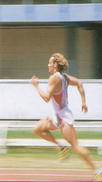
Breathing during Exercise
During exercise more CO2 is produced and not enough oxygen is sent to the muscles.
When exercising it is best to inhale for a longer time than you exhale. This increases the oxygen levels in your blood.

Slide 9
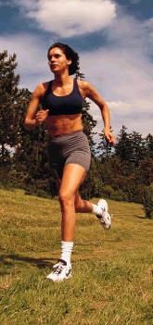
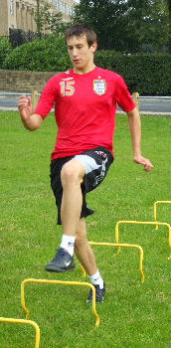
Effects of
Training on the Respiratory System
Immediate effects of training:
Increased rate of breathing
Increase in tidal volume (amount of air breathed in or out of the lungs in one breath)
Effects of regular training:
-Stronger diaphragm and intercostal muscles
-Increased number of alveoli
-Increase in Vital Capacity
(amount of air that can be forcibly exhaled after breathing in as much as possible)
-Increased rate of gaseous exchange
More oxygen delivered
More efficient carbon dioxide removal

Slide 10
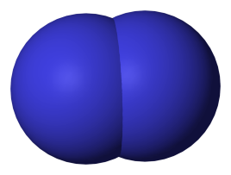
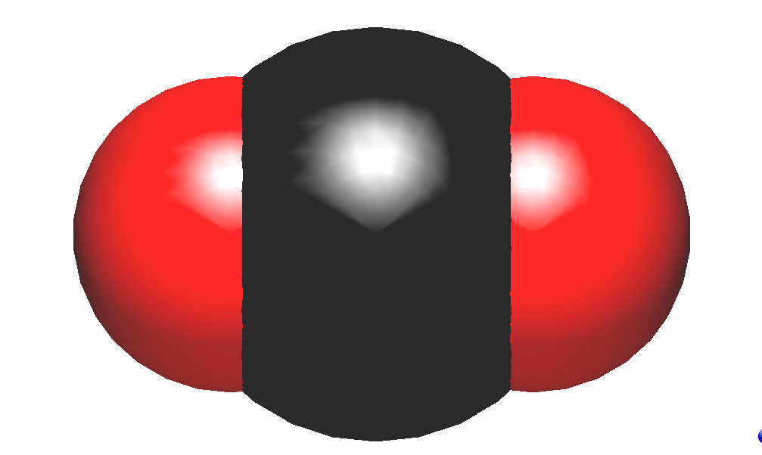
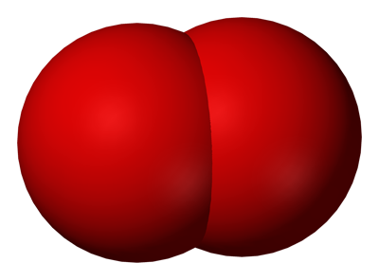
Relative composition of inhaled and exhaled air
Inhaled air has the same composition as normal air, it contains:
Exhaled air contains less oxygen and more carbon dioxide, it is also saturated with water vapour. Exhaled air contains:
78% nitrogen
21% oxygen
1% inert gas such as argon
0.04% carbon dioxide
little water vapour
The difference between the amount of oxygen in inhaled and exhaled air is equal to the difference in the amount of carbon dioxide in exhaled and inhaled air.
78% nitrogen
17% oxygen
1% inert gas such as argon
4% carbon dioxide
saturated with water vapour
The special adaptions of the alveoli for gas exchange are:
Thin walls
Huge surface area
Covered in capillaries to provide blood
A wet lining to dissolve gases

Slide 11


Aerobic and Anaerobic
Aerobic respiration
Anaerobic respiration
Aerobic respiration uses oxygen to oxidise glucose and produce energy.
The equation for the oxidation of glucose is:
C₆H₁₂O₆ + 6O₂ → 6CO₂ + 6H₂O + Energy released
Glucose + Oxygen → Carbon dioxide + water + APT(Energy released)
Here are a few examples of common types of aerobic exercise:
if a steady pace is maintained
Swimming
Cycling
Rowing
Jogging
Cycling
When a person is doing very fast or powerful exercise the blood cannot immediately supply enough oxygen so another sort of respiration occurs.
This converts glucose into energy without the need for oxygen and is known as;
anaerobic respiration.
The reaction is:
Glucose → Energy released + lactic acid
The lactic acid builds up in the muscles.
High lactic acid concentrations are painful and felt as cramp.
Examples of anaerobic exercise are:
Sprinting
Weightlifting
Push ups
Pull ups

Slide 12
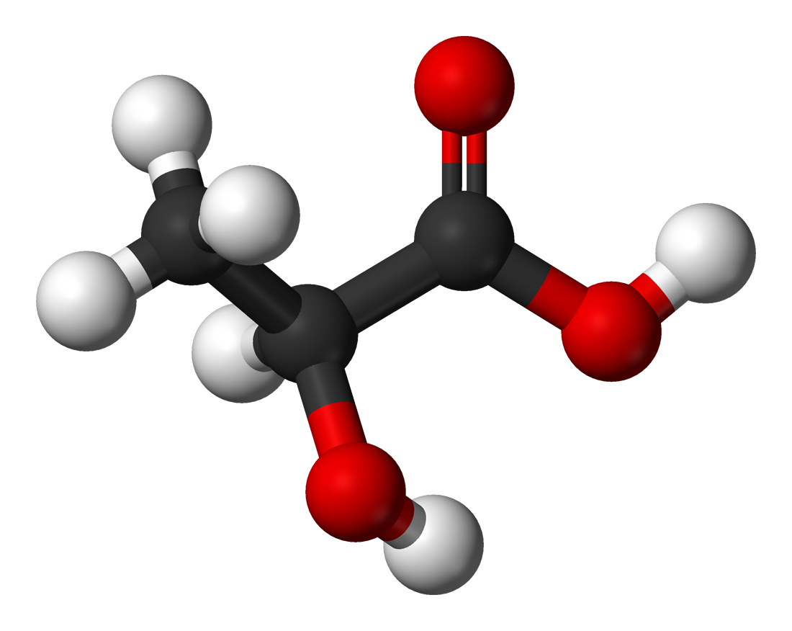
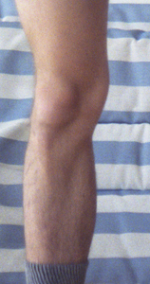
Lactic Acid Production
Lactic acid is a chemical structure made out of carbon, hydrogen, and oxygen. It is also known as milk acid. Lactate is produced in the body during a chemical reaction, but lactic acid doesn’t form under such simple conditions.
During hard exercise when anaerobic respiration occurs with aerobic respiration, an oxygen debt builds up. This is because glucose is not broken down completely to form carbon dioxide and water. Some of it is broken down to form lactic acid. Panting after exercise provides oxygen to breakdown lactic acid. The increased heart rate also allows lactic acid to be carried away by the blood to the liver, where it is broken down
You can start to build up a resistance to lactic acid by working out at a medium intensity during your workouts. This means that you are working just hard enough to get your heart pumping fast and your lungs working a little harder.

Slide 13
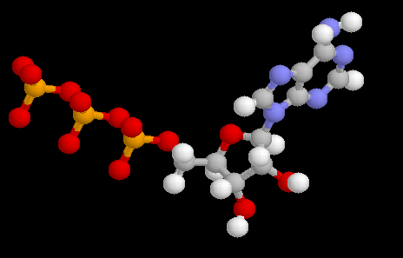
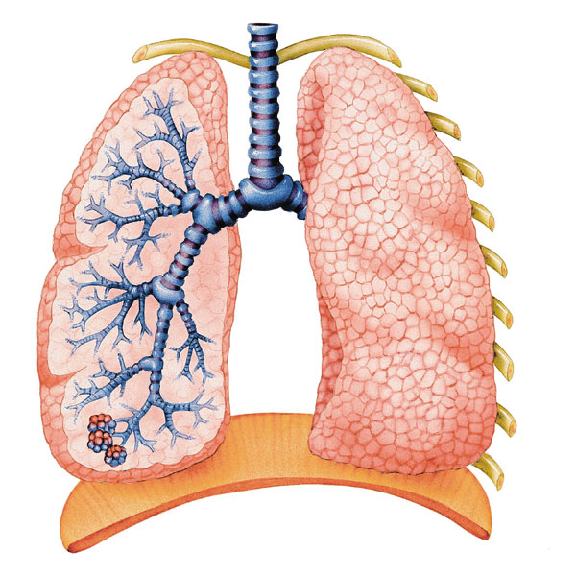
Useful Terms
Oxygen Debt: The amount of extra oxygen required by muscle tissue to oxidize lactic acid and replenish depleted ATP and phosphocreatine following vigorous exercise.
Vital Capacity: The amount of air that can be forcibly expelled from the lungs after breathing in as deeply as possible.
Tidal Volume: The volume of air inhaled and exhaled with each breath.

